Slide 1


Note: This is a summary of Challenge Based Learning (C.B.L.) for MDA 5302 –Human Perception & Information Visualization Unit
© KCA -University
K-UNITY SACCO CREDIT RATING INSIGHTS
Group 1 Presentation
Members:
22/00243 - Maina Julius Mwangi
21/07064 - Charles Ndegwa
21/06739 – Agonyo Laureen
4. 21/08050 – Boniface Kimoni
5. 21/07392 – Victor Omuyoma
6. 21/07828 – Esther Kimani

Slide 2
Agenda
Introduction
Background
Problem Statement
Objectives
Insights and recommendation

Slide 3
Introduction
Sacco’s have been recognized worldwide as important avenues of economic growth.
SACCOs play a significant role in the provision of financial services to the poor (target groups). They provide savings and credit and investment opportunities to individuals, institutions and group members. Sacco’s perform an active financial intermediation function, particularly mediating from urban and semi-urban to rural areas, and between net savers and net borrowers while ensuring that loan resources remain in the communities from which the savings were mobilized.
The SACCO Sub-sector is a key player in realization of vision 2030 of mobilizing savings for Kenya's investment needs. There are 5,000 registered SACCOs with 230 operating Front Office Service Activity (FOSA). The SACCOs have mobilized savings to the tune of Ksh. 420 billion with an asset base of Kshs. 500 billion. The savings account for 35% of the national savings.

Slide 4
Background
K-Unity (formerly Kiambu Unity Finance cooperative union Ltd) is a co-operative union established under the Ministry of Co-operatives and Marketing, registered under the Co-operative Society’s Act Cap 490 of the Laws of Kenya.
It was established in 1974 as a result of the amalgamation of the then Limuru Marketing Co-operative Union and Kiambu Dairy Marketing Union to act as a means of facilitating savings and credit facilities for Dairy & Pyrethrum societies within Kiambu County. Currently it has an asset base of over 5.1 Billion, and with over 100,000 Members in five counties, namely Kiambu, Nairobi, Nakuru, Narok, and Nyandarua.
Besides providing savings and credit services the SACCO has other business lines which include property which manages Mapa House, Githunguri, Kiriita, Limuru, Wangige and Kikuyu buildings and Mapa Insurance Agency which has been operational for over 20 years.

Slide 5
Problem Definition
Saccos have been linked with poor performance over the past few years. This may be attributed to:
1.Poor utilization of surplus and reserves
2. Mis-management of funds and poor dividend and investing decisions.
3. Poor credit decision making among other factors.
This project focuses on poor credit decision making and tries to find ways in which K-Unity Sacco can reduce her non-performing loans by gauging the credit worthiness of their customers. Credit scoring therefore becomes paramount to achieve this object.

Slide 6
Objectives
MAIN OBJECTIVE
The main objective of this Sacco project is to come up with a credit scoring model to help the Sacco in reducing the Non-performing loans/mitigate on bad borrowing
SPECIFIC OBJECTIVES
Which client is likely to default on loan payment?
When are they likely to default in their payments?
Perform credit ratings of the members/borrowers?
A general visual analytics survey on K-UNITY members data?
Perform a visual analysis of Non-performing loans?
Visual analysis of Networked guarantee loans risk management?
Develop a visual analytics system for consumer credit risk analysis
Deep-dive of the performance of individual products and advise accordingly

Slide 7
Findings
We clustered the customers into 3 clusters and investigated the traits of every cluster.
In this section we will present our findings and offer recommendation where possible

Slide 8
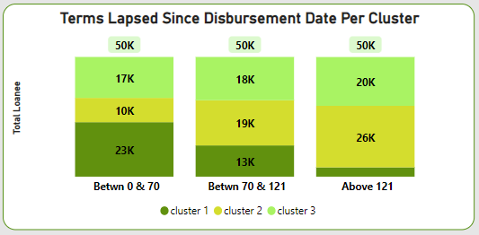
1. Terms the Loan was Active – Cluster 1
Most of their loans have been active for a range of 0 to 70 terms.
A new feature “terms lapsed” was engineered during data preparation. It represented the number of terms per loan since disbursement. If equal or less than the variable terms, the better.
It therefore may be assumed that cluster 1 loans were less defaulted.

Slide 9
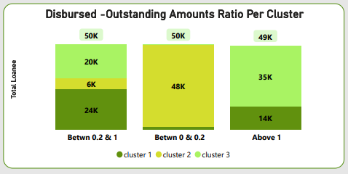
2. Disbursed Vs Outstanding Amount Ratio -Cluster 1
Majority have a disbursement amount to outstanding amount ratio of 0.2 and above
The higher this ratio is the better as it means that the disbursed amount was higher than the outstanding loan
This can be generalized to mean that cluster 1 loans were better serviced compared to the others

Slide 10
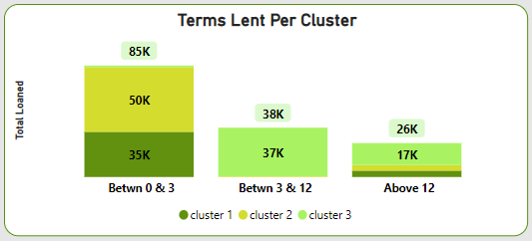
3. Term Limit -Cluster 1
Most of their loans are short-term (0-3 months period)
This group of loans were short term mostly. This may mean they are more secure as the time horizon is short reducing the uncertainties of the future

Slide 11
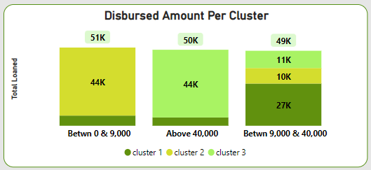
4. Disbursed Amounts –Cluster 2
Most of their loan amounts are between Ksh. 9,000 and Ksh. 40,000
This group of loans were small in size. This may mean their risk magnitude incase of default is not big thus may not mainly impact the business negatively.

Slide 12
5. Terms the Loan was Active – Cluster 2
Most of their loans have been active for 70 terms and above.
As discussed in the previous slide, the less the time span since disbursement of loan the better.
It therefore may be concluded that cluster 2 loans were more defaulted than the rest as the time lapse was prolonged (70 and above)

Slide 13
6. Disbursed Vs Outstanding Amount Ratio -Cluster 2
Majority have low disbursement amount to outstanding amount ratio of 0-0.2.
The higher this ratio is the better as it means that the disbursed amount was higher than the outstanding loan
This can be generalized to mean that cluster 2 loans were poorly serviced compared to the other groups.

Slide 14
7. Term Limit -Cluster 2
Most of their loans are short-term (for 0-3 months period)
This group of loans were short term mostly. This may mean they are more secure as the time horizon is short reducing the uncertainties of the future

Slide 15
8. Disbursed Amounts – Cluster 2
Majority of their loans are in small amounts of loans ( Ksh. 9,000 and below )
This group of loans were small in size (9,000 and less). This may be interpreted to mean that their returns are also low, therefore not constituting a great percentage of the sacco proceeds

Slide 16
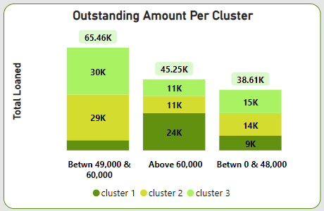
9. Outstanding– Cluster 2
Majority of their outstanding loans are medium loans ranging from 49,000 to 60,000 on average.
Bearing in mind that this group’s disbursed amounts were 9,000 on average, these amounts of withstanding loans are huge.

Slide 17
10. Disbursed Amounts –Cluster 2
Most of their loan amounts are between Ksh. 9,000 and Ksh. 40,000
This group of loans were small in size. This may mean their risk magnitude incase of default is not big thus may not mainly impact the business negatively.

Slide 18
11. Disbursed Vs Outstanding Amount Ratio -Cluster 3
Majority have a disbursement amount to outstanding amount ratio of 0.2 and above
The higher this ratio is the better as it means that the disbursed amount was higher than the outstanding loan
This can be generalized to mean that cluster 3 loans were well serviced compared to the cluster 2.

Slide 19
7. Term Limit -Cluster 3
Most of their loans are long term, i.e., 3 months and above.
This group of loans were long term mostly. This may mean that they well guaranteed with collaterals and guarantors. May also mean that they are business loans taken by businesses thus more secure and higher returns.

Slide 20
8. Disbursed Amounts – Cluster 3
Majority of their loans are in huge amounts of above Ksh. 40,000
This group of loans were huge in size. This may mean that they well guaranteed with collaterals and guarantors. May also mean that they are business loans taken by businesses thus more secure and higher returns.

Slide 21
8. Outstanding– Cluster 3
Majority of their outstanding loans are medium loans ranging from 49,000 to 60,000 on average.
Bearing in mind that this group’s disbursed amounts were huge -40,000 and above on average, these amounts of withstanding loans are less alarming (in the range of 49000-60000).
This may mean they are well serviced. This could be the best types of loans that the business should concentrate on!

Slide 22
~End~

